Slide 1
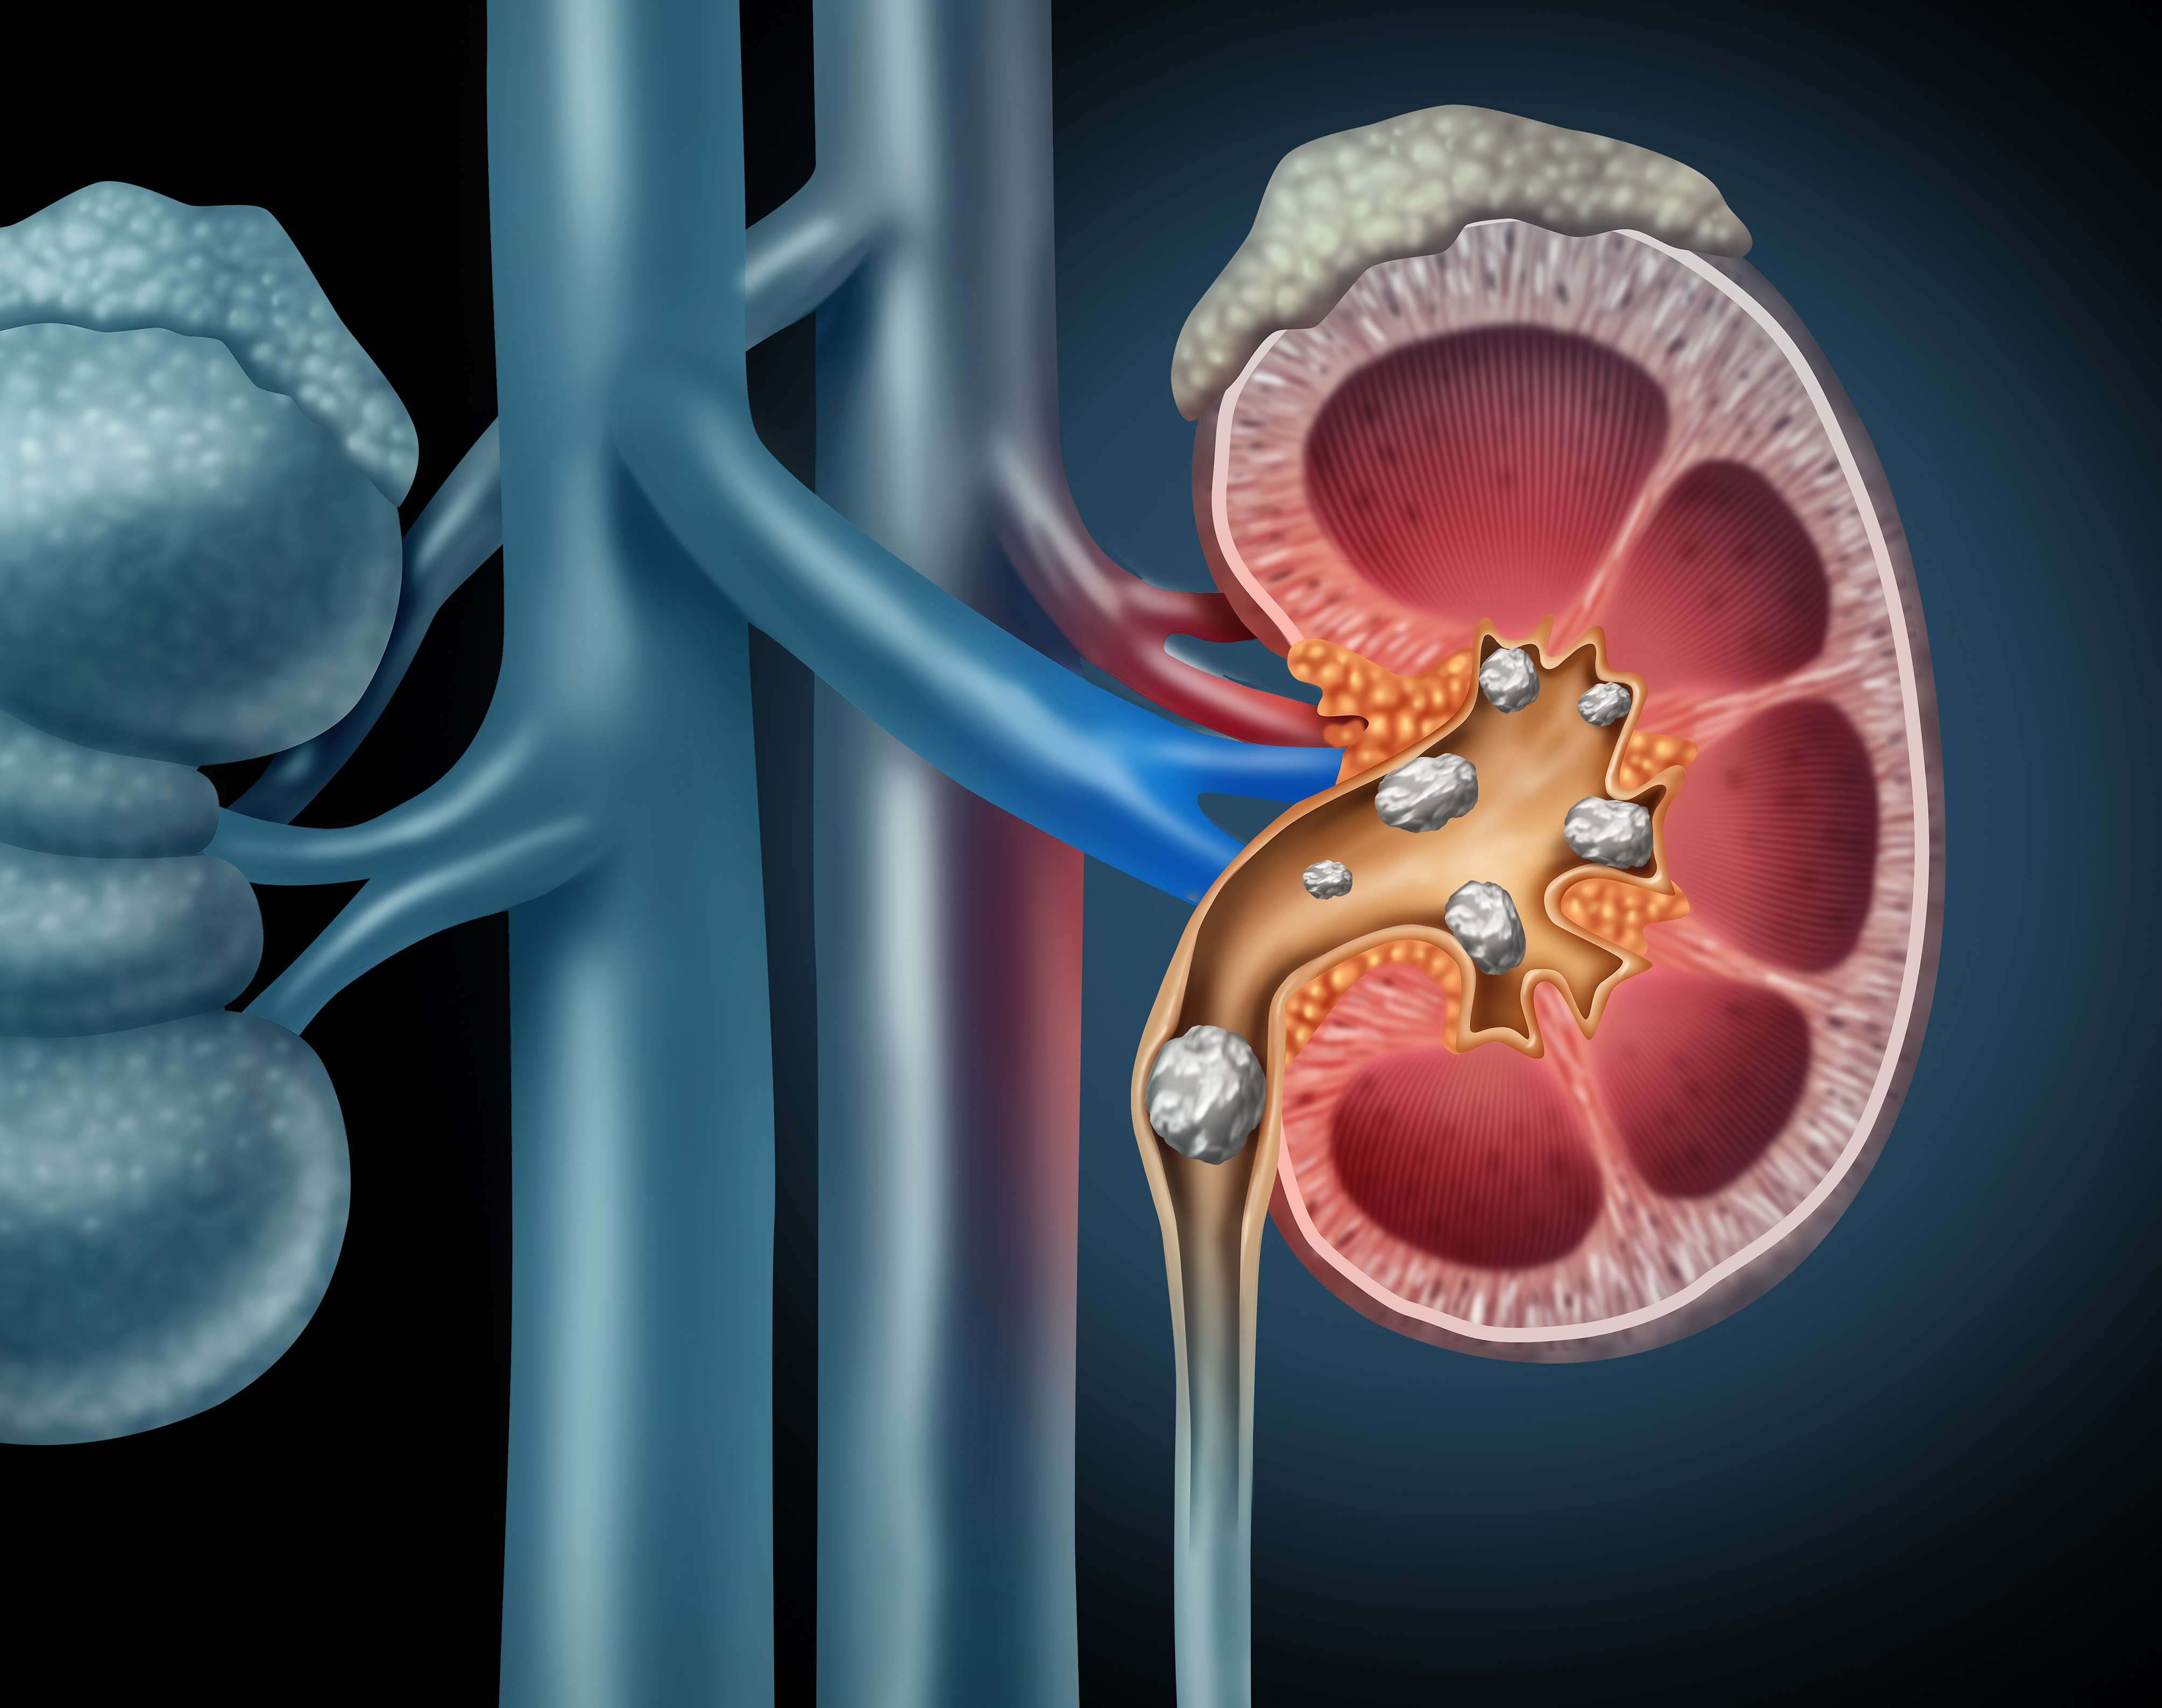
Kidney Stone Prediction based on Urine Analysis
Mai Le

Slide 2

Exploratory Analysis
Objective: Find optimal machine learning models by analyzing urine specimens to determine if certain physical characteristics of the urine might be related to the formation of calcium oxalate crystals or kidney stones.
Methods:
Random Forest
K Neighbors Classifier
Logistic Regression
Kaggle dataset by Vuppala Adithya Sairam (413 specimens)
Extracted from 'Physical Characteristics of Urines With and Without Crystals’, a chapter from Springer Series in Statistics (79 specimens)
Notes:
There are 413 specimens found within the dataset and there are no null values or duplicates found.
79 specimens in original dataset

Slide 3
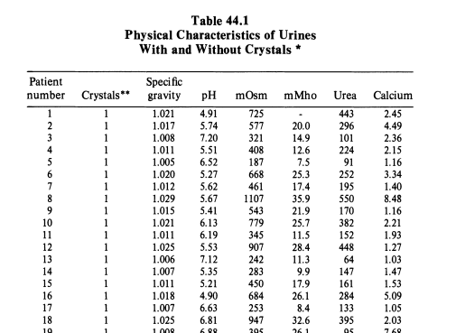
Data Overview
The six physical characteristics of the urine are:
specific gravity, the density of the urine relative to water;
pH, the negative logarithm of the hydrogen ion;
osmolarity (mOsm), a unit proportional to the concentration of molecules in solution;
conductivity (mMho milliMho). One Mho is proportional to the concentration of charged ions in solution;
urea concentration in millimoles per litre; and
calcium concentration (CALC) in millimolesllitre.

Slide 4
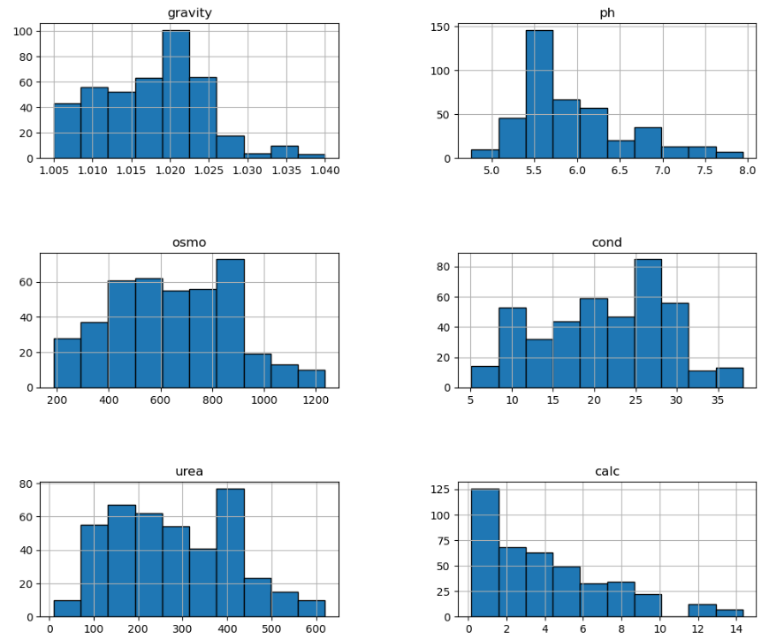
Exploratory Analysis
The six physical characteristics of the urine are:
specific gravity - Typical healthy range of density of the urine relative to water is 1.005 – 1.030
pH – Typical healthy range is 4.5 – 8. pH < 5.5 is also associated with uric acid crystals which promotes formation of calcium oxalate crystals.
Osmolarity – Concentration of particles found in urine. Typical healthy range is 50 – 1200 mOsm/kg.
Conductivity – Amount of ions, such as sodium, potassium, calcium, chloride, or nitrite, in urine.
Urea concentration – Waste byproduct of the breakdown of protein, which increases the amount of acid produced in the body. Typical healthy range 1.8 – 7.1 mmol/l.
Calcium concentration – Typical healthy range is 2.50 – 7.50 mmol/24 hours.
Notes:
All of the predicting features do not have multivariate normal distribution, which is understandable given the nature of the data. The values are all positive and appear to be evenly distributed or right skewed. Specifically, gravity and calc have outliers toward the right tail of the distribution.
Below I have provided a brief understanding of these features to help understand the distribution better:
1. **gravity** - Typical healthy range of density of the urine relative to water is 1.005 to 1.030.
2. **pH** - Typical healthy range is 4.5 to 8. pH 7 is neutral. However, pH under 5.5 is also associated with uric acid crystals which promotes formation of calcium oxalate crystals.
3. **osmo** - Concentration of molecules/particles found in urine. Typical healthy range is 50 to 1200 mmol/kg
4. **cond** - Amount of electrolytes, such as sodium, potassium, calcium, chloride, and nitrite, in urine. Unfortunately, it is unclear what kind ions were measured in this study.
5. **urea** - Waste byproduct of the breakdown of protein, which increases the amount of acid produced in the body. Low levels of urea is associated with kidney problems, or malnutrition from lack of protein. High urea means overactive kidneys or too much protein; Typical healthy range is 1.8 to 7.1 mmol/l.
6. **calc** - Typical healthy range is 2.50 to 7.50 mmol/24 hours. Levels higher than this range is associated with leaking of calcium from the kidneys into the urine which causes kidney stones.

Slide 5
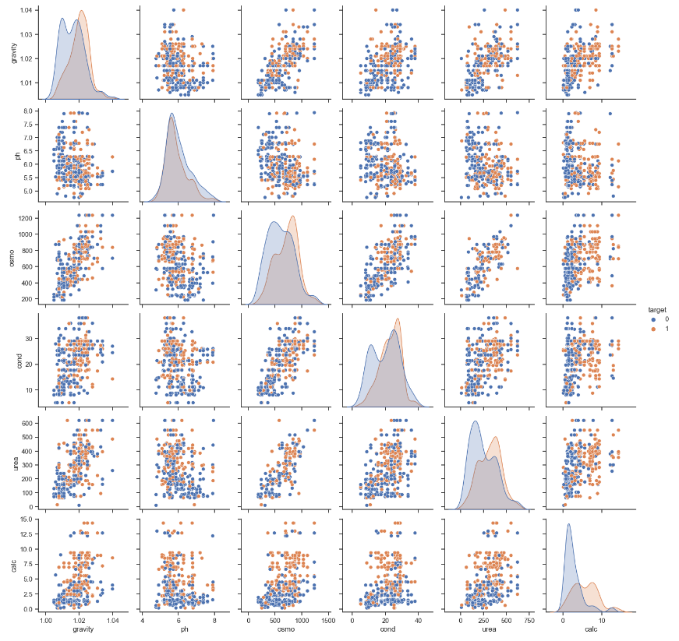
Exploratory Analysis
Point of interest - Distribution of presence/absence of kidney stone
Issues with data:
Multicollinearity between predictors
gravity vs. osmo (0.69),
gravity vs. urea (0.63),
osmo vs cond (0.71),
osmo vs. urea (0.81),
cond vs. urea (0.50).
Non-multivariate normal distribution of predictors
Notes:
There are strong multicollinearity issues between gravity vs. osmo (0.69), gravity vs. urea (0.63), osmo vs cond (0.71), osmo vs. urea (0.81), cond vs. urea (0.50).
Additionally, we can see in this view that cases with kidney stones seem to cause right skew found in the calc feature. Similarly, the median of the distribution of kidney stones cases appear larger than the cases with absence of the stones.

Slide 6
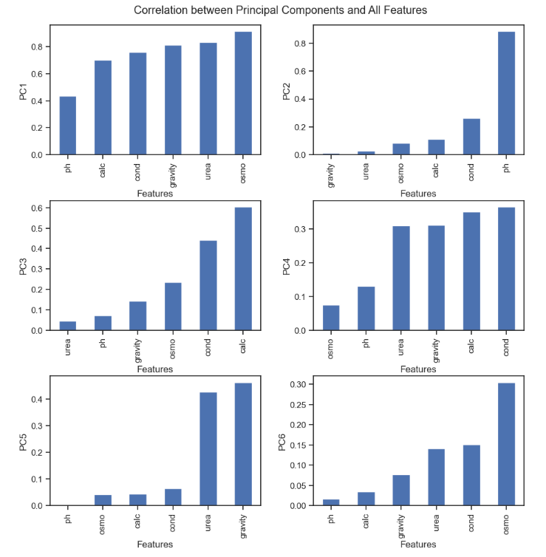
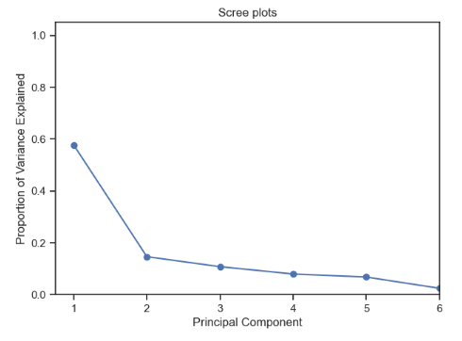
Principal Component Analysis
PC1, PC2, PC3, PC4 account for 90% of the variation in the data.
The top loadings of each PC:
PC1 - all features except for pH
PC2 - pH
PC3 - calc and cond
PC4 - urea, gravity, calc, cond

Slide 7
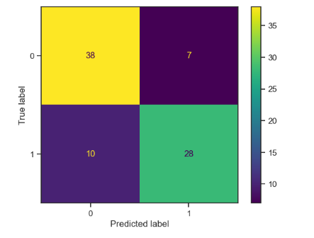
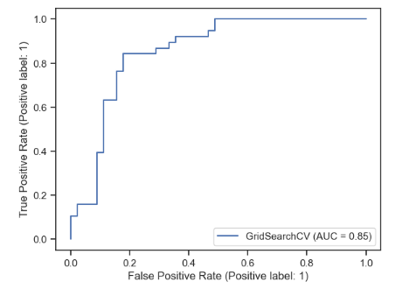
Random Forest
Used Grid Search CV to find optimal hyperparameters
The number of trees in the forest: 300
The maximum depth of the tree: 7
The minimum number of samples required to be at a leaf node: 1
The minimum number of samples required to split an internal node: 2
The number of features to consider when looking for the best split: sqrt(4) = 2
Notes:
Scikit-learn's GridSearchCV is a method for hyperparameter tuning that exhaustively searches over a specified hyperparameter grid to find the optimal set of hyperparameters for a given estimator, using cross-validation to evaluate the performance of each set of hyperparameters. It returns a fitted estimator with the optimal hyperparameters found during the search.
max_features{“sqrt”, “log2”, None}, int or float, default=”sqrt”The number of features to consider when looking for the best split:
If “sqrt”, then max_features=sqrt(n_features).
If “log2”, then max_features=log2(n_features).
If None, then max_features=n_features.

Slide 8
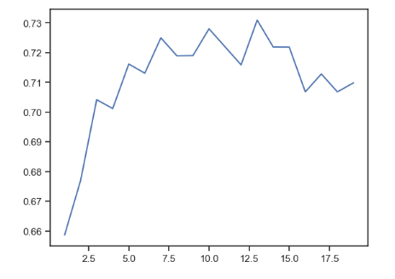
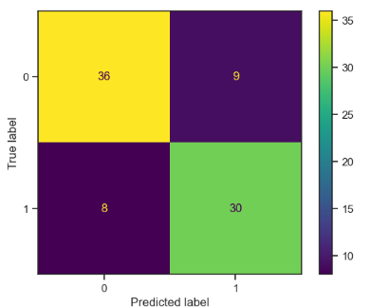
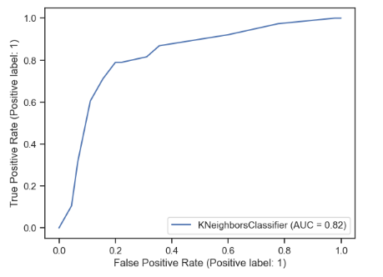
K Neighbors Classifier
Used R squared to find optimal number of neighbors – k = 13

Slide 9
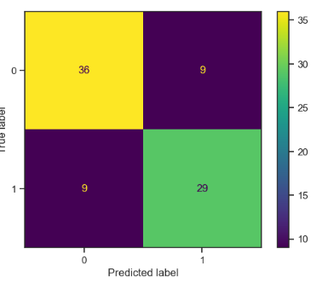
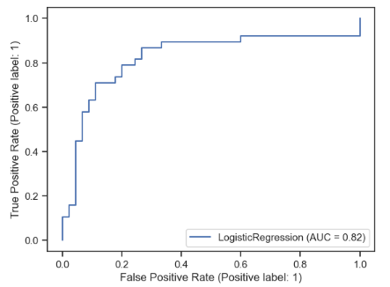
Logistic Regression
Notes:
the last model will also serve as a benchmark for the other two because of its simplicity.

Slide 10
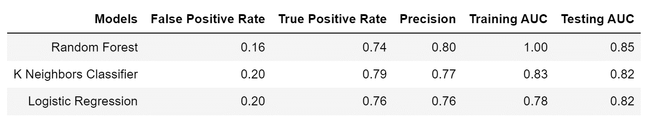
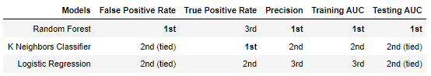
Conclusion
Optimal Model – Random Forest
Notes:
The table below summarizes results of all models rounded to the nearest 2 decimal places. However, it should also be noted that we have not completely explored all machine learning models. There are many robust ensemble models like XGBClassifier, Gradient Boosting, or a combination of all of the mentioned models in this project.
False positive rate shows the probability of presence of kidney stones will be given when the true value is absence of kidney stones. Random Forest outperforms other models at 16% false positive rate.
True positive rate shows the probability of an actual presence of kidney stones will test for presence of kidney stones. K Neighbors Classifier outperforms other models at 79% true positive rate.
Precision shows that out of all the specimens who were identified to have presence of kidney stones, how many really have presence of kidney stones. Random Forest outperforms other models at 80% precision.
The benchmark for AUC is a random classifier with 0.5 AUC, therefore all models have relatively good AUC results for both training and testing dataset. Once again, Random Forest outperforms other models with almost perfect training AUC and the highest testing AUC. However, this also shows us that this model is likely overfit and the more similar AUC results of K Neighbors Classifier might be more desirable.
Based on the results above, we can rank the model as follow and it appears that Random Forest is the best model to predict the probability of presence of kidney stones.

Slide 11
References
https://labs.selfdecode.com/blog/urine-ph/#:~:text=The%20normal%20range%20of%20urine,affect%20the%20pH%20of%20urine.
https://www.ncbi.nlm.nih.gov/pmc/articles/PMC7423618/#:~:text=Analyzing%20electrolytes%20in%20urine%2C%20such,tract%20infection%2C%20and%20cystic%20fibrosis.
https://www.mountsinai.org/health-library/tests/osmolality-urine-test#:~:text=An%20osmolality%20test%20measures%20the,congestive%20heart%20failure%20or%20shock.
https://www.ucsfhealth.org/medical-tests/calcium---urine#:~:text=Normal%20Results,(mmol%2F24%20hours).
https://www.ucsfhealth.org/medical-tests/urine-specific-gravity-test#:~:text=The%20normal%20range%20for%20urine,of%20your%20specific%20test%20results.

Slide 12
Appendix
Hyperparameters for Grid Search
param_dist = {
'n_estimators': [100,300],
'max_depth': [3,5,7],
'min_samples_split': [2],
'min_samples_leaf': [1],
'max_features': ['sqrt', 'log2', None]}

